Slide 1
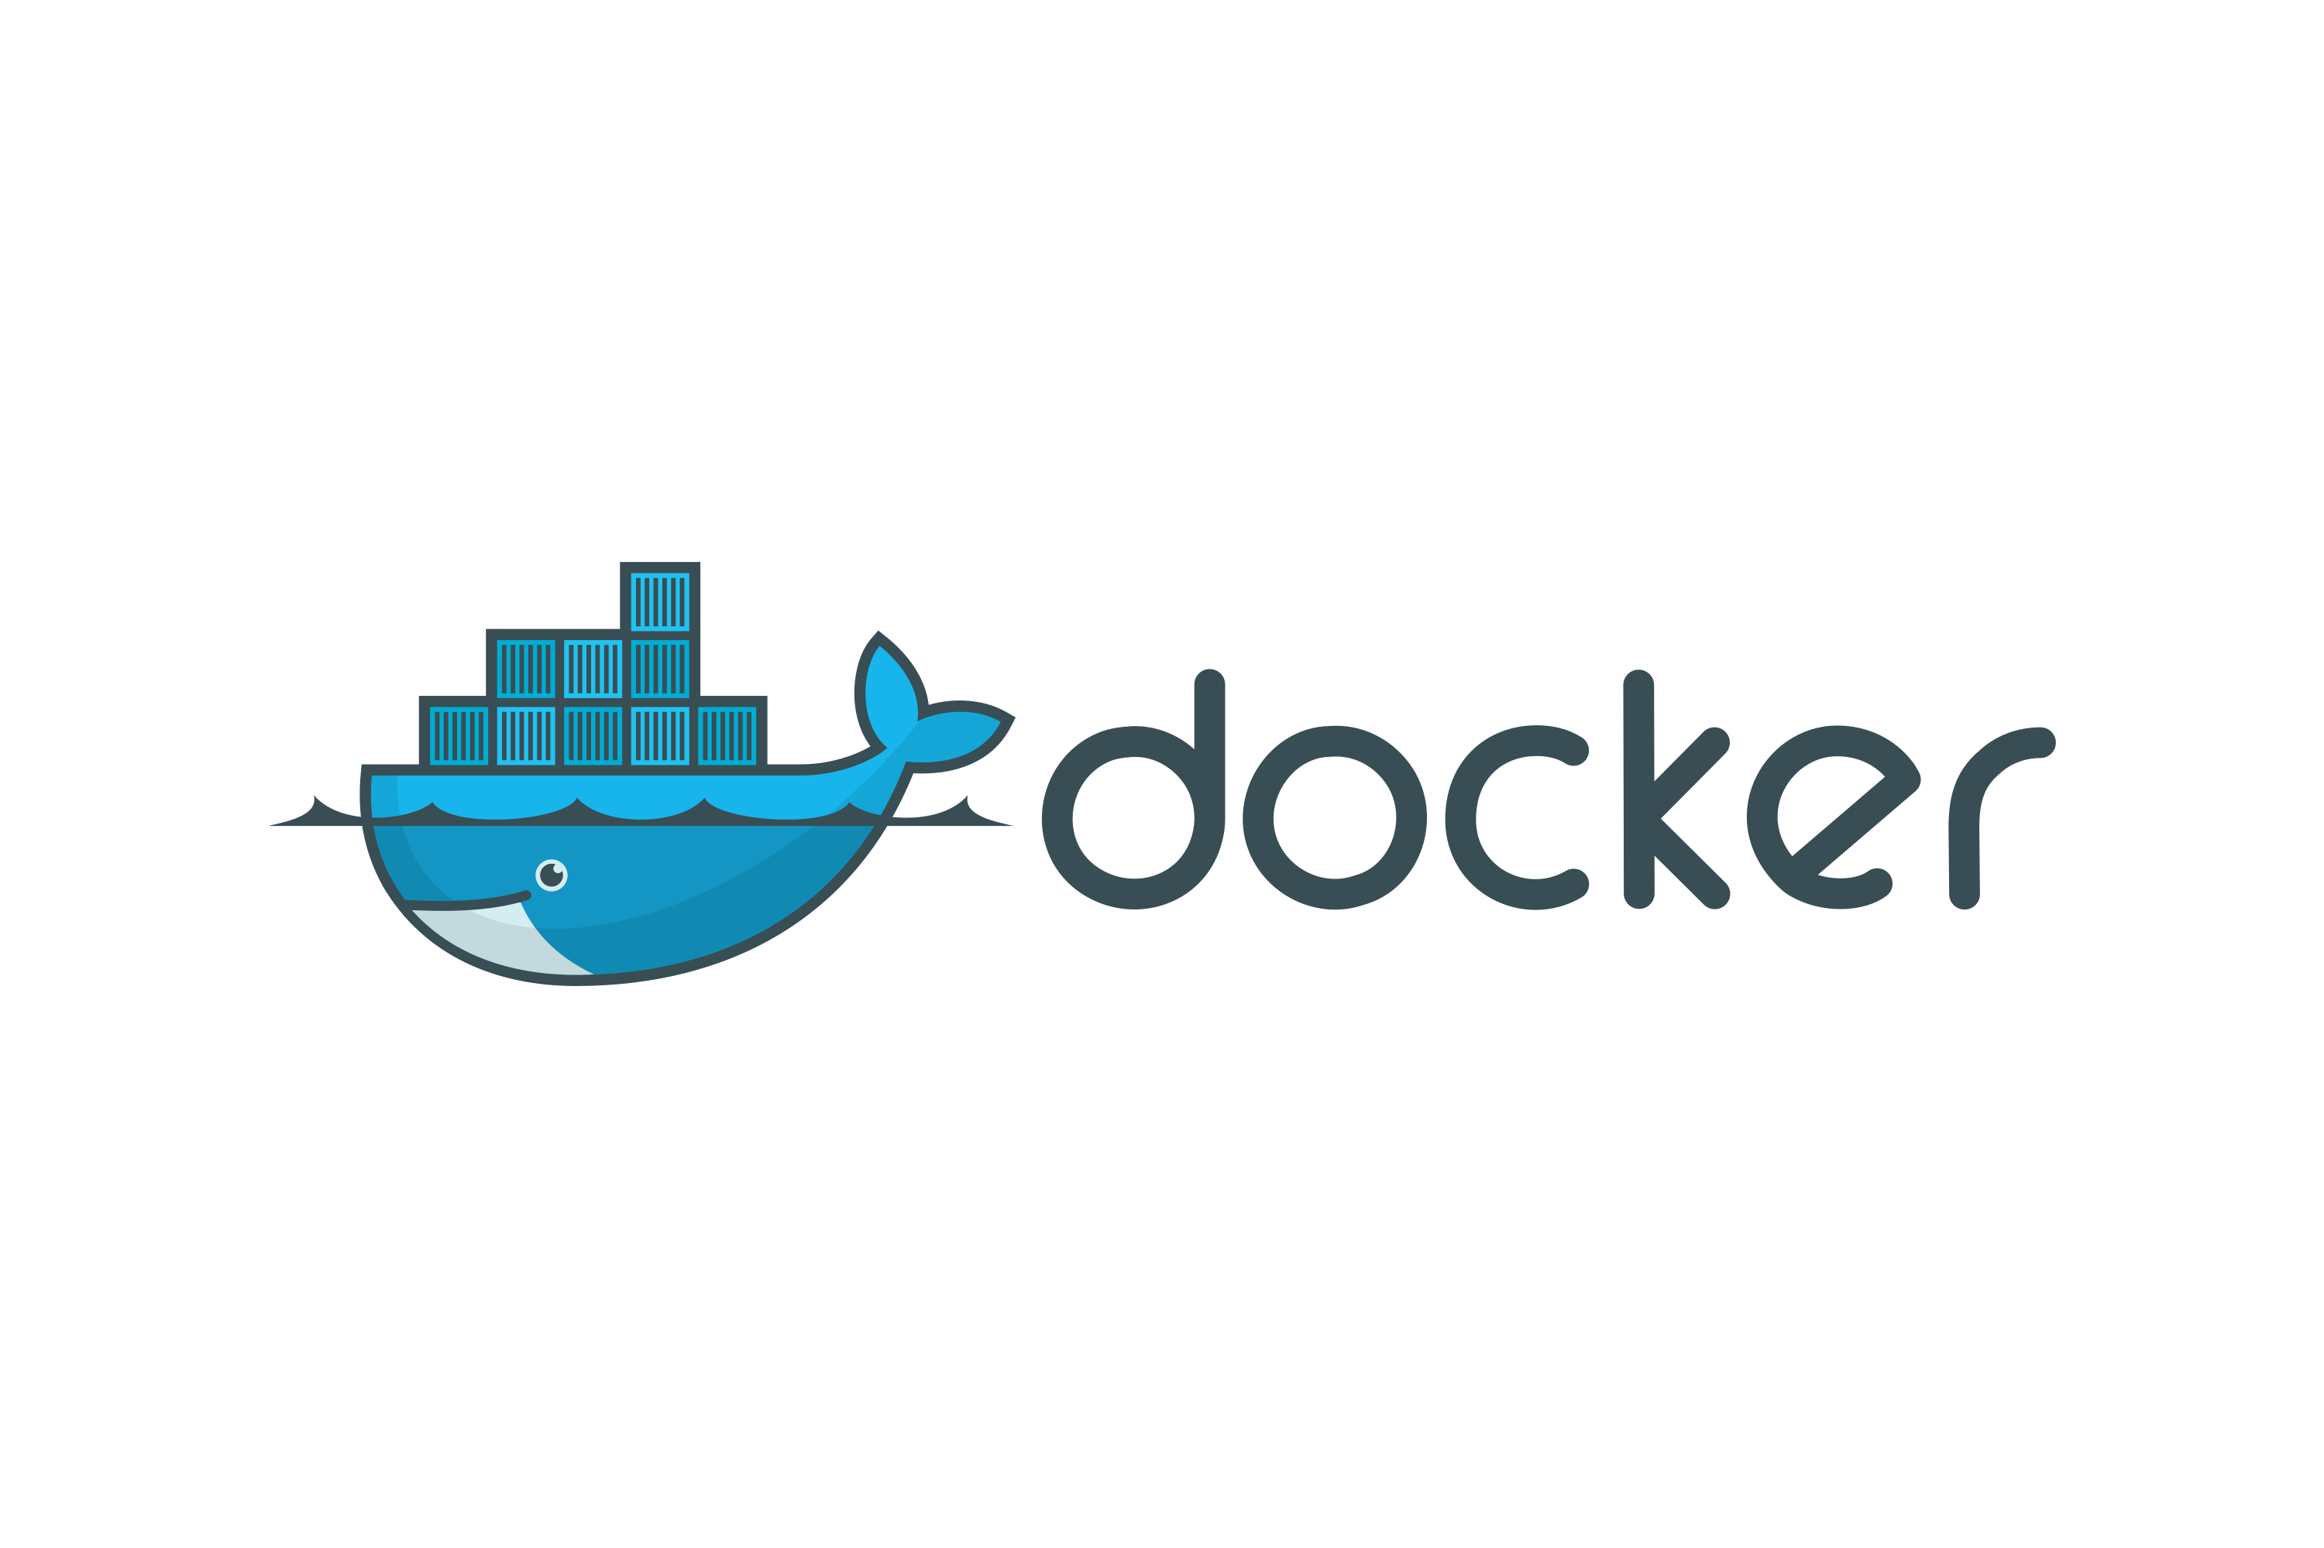
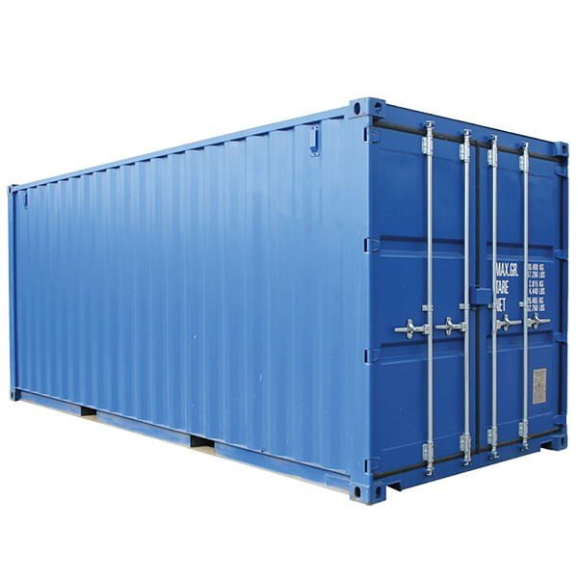
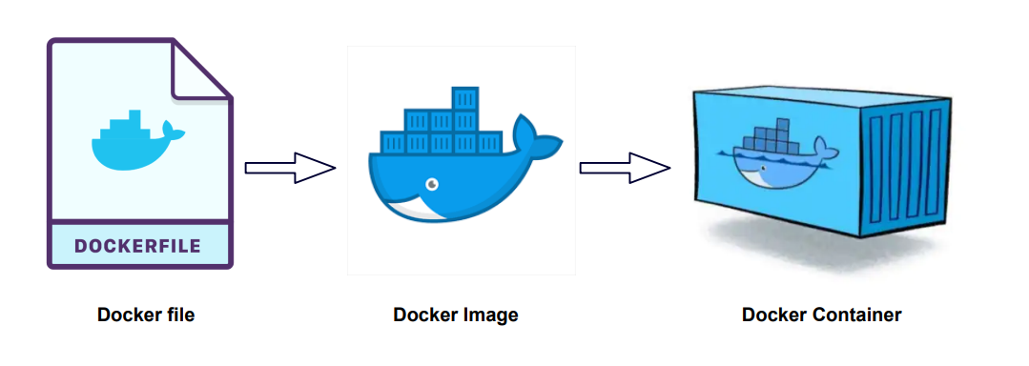
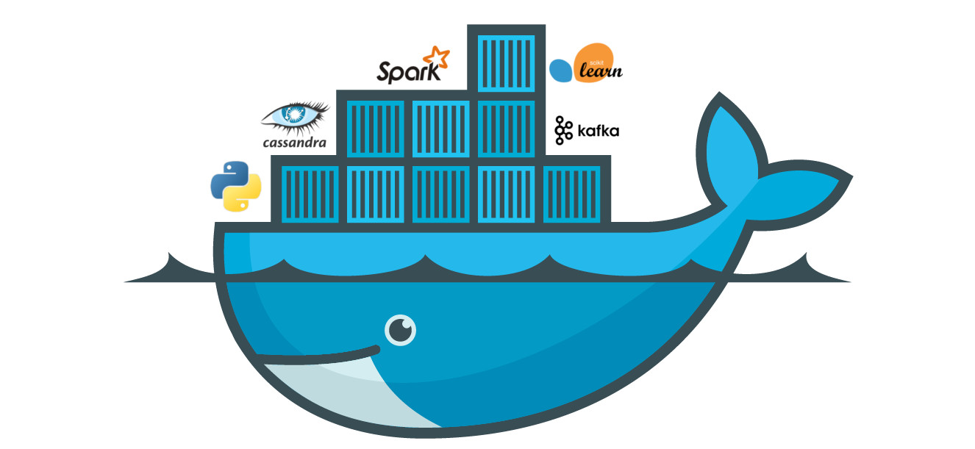
Docker
Senior Application Developer, IBM Mysuru.
navaneethan.s@ibm.com
Notes:
This session is all about Docker - an amazing technology which makes managing and deploying and also developing more complex applications way easier.
You are going to know what exactly is docker, it is something related to containers and I am also going to explain you that.
Throughout this session, you are going to learn how to work with docker and containers, which commands to run, what you can do with docker, how to solve different problems with docker, How to use it locally on your machine, how to use it in simple projects and more complex projects, how to deploy projects and applications with docker and understand what might be the advantage of using docker.
(And you will also know about what Kubernetes is and how it is related to docker… )
And we are going to dive into these concepts in theory.. yes.. but most importantly with lots of demos and examples..
We are not going to write any code. This is not a programming session like teaching a specific language. Instead I will provide small examples to you and you’ll use these examples to dive into the different problems we might face and gonna learn how docker’s gonna solve these problems for us. Thats the idea for this session!
So we will start at ZERO !…. No prior docker knowledge is required. We will see the different problems docker can solve for us and also the different features it offers for us step by step.
At the end of the session, you will feel comfortable using docker in your next projects, you’ll know what it is ? And you will be ready to deep dive into it like advanced scenarios…So lets not waste any time further.. and lets start with the most important question ?? What is Docker? Why is it important ? What are its advantages?

Slide 2
Agenda:
Different Roles - What to take away? Developers, Testers, Support etc
Technology Agnostic - Works for every programming / tech stack.
Cloud Native Apps - Works on all types of Cloud & in your local environment as well.
Competitor - Virtualization, Ansible etc.
Limitations of docker
Success Case Studies / Sample use cases
Getting Started with Docker.
Core Building Blocks - Docker Images & Containers
Hands-on : Dockerizing Node.js Application
Useful Docker Commands
IBM Service offerings, courses, credentials, digital badge

Slide 3
Agenda:
Managing Data and working with volumes
Networking: Cross-Container Communication
Building Multi-Container Applications with Docker
Docker Compose : Elegant Multi-Container Orchestration
Working with Utility containers & executing commands in container
Using Docker for complex projects
Deploying Docker Containers
Docker & Containers - Summary

Slide 4
What is Docker?
Recap of docker…
What problem does it solve ?
Why do we need docker ?

Slide 5
What is Docker?
Docker is a container technology: A tool for creating & managing containers.
A standardized unit of software
A package of code and its dependencies to run that code
(eg. Node.js code + the Node.js Runtime)
The same container always yields the exact same application and execution behaviour! No matter by where or by whom it might get executed
Support for containers is built into modern operating systems.
Notes:
Lets start with the most important question ? What exactly is docker ? And Why ?
Docker in the end is a container technology. Its a tool for creating & managing containers. That’s clearly is a nice sentence. But what does that mean ?
What is a container ?? What does container mean in software development? And why we might want to use it ?
Well, A container in software development is a standardised unit of software. Which basically means its a package of code and the dependencies & tools required to run that code. (e.g NodeJ.js code + the Node.js runtime)
Suppose you are building a node.js application (its a JS runtime for running JS code on a server).
If you have such an application, with container build with docker, you could have your application source code in that container as well the the node.js runtime and any other tools you might need to run that code.
The advantage is the same container always yields the exact same application and execution behaviour! No matter by where or by whom it might get executed. (The node.js code + node.js runtime with same version and the tools required with the exact same version - will always give you the exact same result ). You don’t have any surprises. Bcoz all baked into the container. Its always the same.
Always it is easy to understand this concept by taking a step back.

Slide 6

A picnic basket
Dishes
Food
Notes:
A picnic basket contains everything you need to have a picnic. Dinner in the park something like this.. It contains the food, dishes which you need, and therefore you can take that basket and you can take it everywhere you want to have that picnic and you are ready to go bcoz you have all in that basket.
You can also share that basket with your friend and that friend can have that same picnic you would have it otherwise. There are no surprises. You have the dishes and the fruits. You don’t have to look for dishes at the place you want to eat. General idea here is “If you pack your own picnic basket, everything you need its all in there” Thats the idea of a picnic basket and that’s the same idea behind containers and dockers ( just a tool for creating and managing the containers ) too..

Slide 7
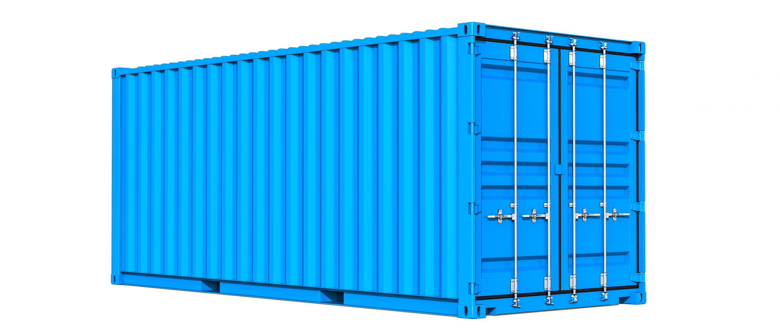
Container
Notes:
Now the term, container might be strange at first. If you hear about a container, you might think something like this.. At least that is what I know as a container. Actually its not a bad comparison. This is the container we would load onto ships, trucks to move goods around. And its the same idea with docker containers still.
We have standardised containers like this, where we fit goods into it so that they are all isolated and are contained within it. The goods in one container don’t get mixed with goods from another container. Now if you need something like cooling, still it can be build into the container and therefore the container works stand alone and it can be put onto any ship or any truck which are able to handle such containers. And thats exactly the same thing with docker containers.
Units of software are packages of code with the dependencies to run this code and we can take it anywhere where docker runs. And you’ll be able to run exactly the same application with the same environment. We don’t need to worry about installing extra tools in that place where we want to run our application. Bcoz its all in the containers.
Now the good thing is…. It is supported in all major OS.

Slide 8
What is Docker?
Docker is a container technology: A tool for creating & managing containers.
A standardized unit of software
A package of code and its dependencies to run that code
(eg. Node.js code + the Node.js Runtime)
The same container always yields the exact same application and execution behaviour! No matter by where or by whom it might get executed
Support for containers is built into modern operating systems.
Docker simplifies the creation and management of such containers
Notes:
Now the support for docker is available in all the operating systems.
Docker also simplifies the creation and management of such containers..
Docker is the defacto standard to create containers since it makes that task so super simple!

Slide 9
Why Containers?
Why would you want independent, standardized “application packages”?
Use Case 1:
We often have different development and production environments.
We want to build and test in exactly ( ! ) the same environment as we later run our app in
Different Development & Production Environments
Notes:
Now we know what is container and we know docker helps us in creating such containers. Also I have outlined some advantages (yielding same output every time etc.. no version conflicts, no more sayings like “It works in his machine and not on mine”)…
Why do we need containers in software development ? Is it really that important ?
We should ourself ask one question. Why would we want independent, standardised “application packages”? In software development.
Main use case:
We often have different development and production environments. Here is an simple example.

Slide 10
Why Containers?
Use Case 1 - Hands on
Notes:
Now we know what is container and we know docker helps us in creating such containers. Also I have outlined some advantages (yielding same output every time etc.. no version conflicts, no more sayings like “It works in his machine and not on mine”)…
Why do we need containers in software development ? Is it really that important ?
We should ourself ask one question. Why would we want independent, standardised “application packages”? In software development.
Main use case:
We often have different development and production environments. Here is an simple example.

Slide 11
The problems
Environment: The runtimes, languages, frameworks you need for development
Development Environment
Production Environment
often not the same
We Want Reliability & Reproducible Environments
(We want to have the exact same environment for development and production -> This ensures that it works exactly as tested)
Notes:
This is where docker can help you. You can lock a specific node version inside the docker container and therefore you can ensure your code gets executed always with that same exact version.
All of a sudden that potential problem is gone and cant occur anymore bcoz your application runs inside that container which brings its own node.js version !

Slide 12
Why Containers?
Why would you want independent, standardized “application packages”?
Use Case 2:
Different development Environments within a Team / Company.
Every team member should have the exactly (!) same environment when working on the same project
Different Development Environments within a team / company
Notes:
Now consider we are working on the same Node.js project. We work in the same team and I have written that code and I am sharing it with you and the same code which works for me doesn’t work for you.
Now you might have a older Node.js version and I may have the latest. So you might be thinking I can update the node.js version and make it work on the other machine.
Now this is just a small example which involves one dependency. In real time there could be many. You might be working with complex projects involving lot many dependencies and its still annoying we can t able to work on the same project. Docker guarantees that we always have the same environment which provides the reproducible environment facility.

Slide 13
The problems
It should be easy to share a common development environment / setup with (new ) employees and colleagues.
Docker can provide the reproducible environments and can guarantee that your code works.
Notes:
This is where docker can help you. You can lock a specific node version inside the docker container and therefore you can ensure your code gets executed always with that same exact version.
All of a sudden that potential problem is gone and cant occur anymore bcoz your application runs inside that container which brings its own node.js version !

Slide 14
Why Containers?
Why would you want independent, standardized “application packages”?
Use Case 3:
Clashing Tools / Versions Between Different projects.
When switching between projects, tools used in project A should not clash with tools used in Project B
Clashing Tools / versions between different projects
Example :
Project A(Node v12) —-> Project B(Node v14) —> Then you should uninstall node v12 and install node v14
Project B(Node v14) —> Project A(Node v12) —> Then you should uninstall node v14 and install node v12
Notes:
Now lets say one project uses python version 2 and other project uses latest version of python. The same can be for node.js , java, php etc. There you might have clashing versions and therefore when you want to switch to different projects you might want to uninstall the wrong version and install the right version.
Switching between projects becomes a hassle and no fun at all.. Docker can help you here.

Slide 15
Why Containers?
Why would you want independent, standardized “application packages”?
Use Case 3:
Clashing Tools / Versions Between Different projects.
When switching between projects, tools used in project A should not clash with tools used in Project B
Clashing Tools / versions between different projects
With Docker, you don’t want to uninstall and re-install local dependencies and runtimes all the time.

Slide 16
Why Containers? - Summary
We want to have the exact same environment for development and production -> This ensures that it works exactly as tested
It should be easy to share a common development environment / setup with (new) employees and colleagues
We don’t want to uninstall and re-install local dependencies and runtimes all the time
Notes:
And now every projects has its own containers and now if we switch the projects, it just work like that. Bcoz its all inside that container. Not globally on our machine / host. And switching projects becomes that easy just like launching a new container.

Slide 17
A Containers
Standardized
unit for
shipping goods
Independent
from other containers
Can be
moved with trucks, ships, cranes…
Self
Containing
Notes:
And now every projects has its own containers and now if we switch the projects, it just work like that. Bcoz its all inside that container. Not globally on our machine / host. And switching projects becomes that easy just like launching a new container.

Slide 18
Solution : Virtual Machines / Virtual OS
App A
App B
App C
Libs, Dependencies & Tools
Libs, Dependencies & Tools
Libs, Dependencies & Tools
Virtual OS
(e.g. Linux)
Virtual OS
(e.g. Linux)
Virtual OS
(e.g. Linux)
Your Operating System
Notes:
Why docker and containers ?
Cant we solve that with Virtual Machines ? Yes kind of.. A computer inside of a computer.
Generally this works. But we have one problem.
Its about the virtual OS and in general the overhead with multiple Virtual Machines.
Every Virtual machine is something like a standalone computer / machine running on top of our machine.
And now if we have a lot of such machines, we have lots of wasted spaces and the device seems to be slow.

Slide 19
Solution : Virtual Machines / Virtual OS
App A
App B
App C
Libs, Dependencies & Tools
Libs, Dependencies & Tools
Libs, Dependencies & Tools
Virtual OS
(e.g. Linux)
Virtual OS
(e.g. Linux)
Virtual OS
(e.g. Linux)
Wastes a lot of space on your hard drive and tends to be slow.
Your Operating System
Notes:
Why docker and containers ?
Cant we solve that with Virtual Machines ? Yes kind of.. A computer inside of a computer.
Generally this works. But we have one problem.
Its about the virtual OS and in general the overhead with multiple Virtual Machines.
Every Virtual machine is something like a standalone computer / machine running on top of our machine.
And now if we have a lot of such machines, we have lots of wasted spaces and the device seems to be slow.
Bcoz every time a brand new computer has to be setup inside our machine and thats eats up memory , CPU and memory on our hard drive and that can really become a problem if you have more and more virtual machines on your system. Its like every OS is Linux and still you are installing separately and thats waste of space.
Further the OS also has some other tools and libraries which your application never needs but still are part of OS by default.
It can have Pros and Cons.

Slide 20
Virtual Machines / Virtual OS: Summary
Pros:
Separated Environments
Environment Specific configurations are possible
Environment configurations can be shared and reproduced reliably
Cons:
Redundant duplication, waste of space
Performance can be slow, boot times can be long
Reproducing on another computer server is possible but can be tricky

Slide 21
How docker outperforms Virtual Machines?
container
container
container
App A
App B
App C
Libs, Dependencies & Tools
Libs, Dependencies & Tools
Libs, Dependencies & Tools
Docker Engine
OS Built-in / Emulated Container Support
Your Operating System
Notes:
How containers solve that problems in a better way ?
Host OS —> We don’t install a couple of machines (like we do in Virtual Machines) , instead we utilise the built in container support which our OS has …
Something docker will take care of …
Now we have a tool called docker engine by the way which gets installed when you install docker and docker takes care of all that. Based on docker engine is one light weight small tool which runs on our host machine , we can spin up containers using it.
This containers contain our code and runtime our code needs like lib, dependencies.
But they don’t contain a bloated operating system with tons of extra tools anything like that. They might have a small OS layer inside but even that will be a very light version much smaller than anything you would install in an Virtual OS.
Now you will learn how to create such containers and how to use them etc..
Another advantage of container is … you can configure them and describe them with configuration file and you can share that file with others so that they can recreate the containers. Or you can also built the container using something called as an Image which you need to do anyways.. Then you can share that image with others so that everyone is able to launch the same container.

Slide 22
Containers Vs Virtual Machines
Docker Containers :
Low Impact on OS, very fast, minimal disk space usage
Sharing, Re-building and distribution is easy
Encapsulate apps/Environments instead of “whole machines”
Virtual Machines :
Bigger Impact on OS, slower, high disk space usage
Sharing, Re-building and distribution can be challenging
Encapsulate “whole machines” instead of just apps / environments

Slide 23
Docker setup
Install Docker Toolbox (if req not met)
Mac OS
Windows
Linux
Requirements met ? Yes
Install Docker Engine
on Linux
Install Docker Desktop

Slide 24
Docker Playground
If you cant install docker on your system, you can also look into this online playground
OS
https://labs.play-with-docker.com/

Slide 25
Docker Tools & Building Blocks
Docker Engine
Docker Desktop
Docker Hub
Docker Compose
Notes:
Docker Engine - ultimate install of this is happening.
Docker Desktop -tool that make sure docker engine was installed and docker engine works. It includes the Daemon & CLI - crucial role to run commands..
Docker Hub - a service to host our images in the cloud which you can share with other systems / people - no installation required.
Docker compose - a tool to manage complex containers and multiple containers at once.
Kubernetes - managing complex containerized applications when we deploy.

Slide 26
Docker Images
Its an executable package of software which includes everything you need to run your application.
It informs how a container should instantiate, determining which software components will run and how.
Notes:
Docker Engine - ultimate install of this is happening.
Docker Desktop -tool that make sure docker engine was installed and docker engine works. It includes the Daemon & CLI - crucial role to run commands..
Docker Hub - a service to host our images in the cloud which you can share with other systems / people - no installation required.
Docker compose - a tool to manage complex containers and multiple containers at once.
Kubernetes - managing complex containerized applications when we deploy.

Slide 27
Docker Images
REPOSITORY | TAG | IMAGE ID | CREATED | SIZE
committ | latest | b6fa739cedf5 | 19 hours | 1.089
docker | latest | 30557a29d5ab | 20 hours | 1.089
postgre | 9 | 746b819f315e | 4 days ag | 213.4
postgre | 9.3 | 746b819f315e | 4 days ag | 213.4
postgre | 9.3.5 | 746b819f315e | 4 days ag | 213.4
postgre | latest | 746b819f315e | 4 days ag | 213.4

Slide 28
Basic Docker Commands
docker -v
docker images
docker build -t <image-name:tag> -f <path/to/Dockerfile> .
docker rmi <image-name-or-image-id>
docker ps
docker ps -a
Source: https://docs.docker.com/engine/reference/commandline/docker/

Slide 29
Basic Docker Commands
docker rm <container-name-or-id>
docker image prune
docker run -p 9000:8080 <image-name>:<tag>
Docker image pull <image-name>
Source: https://docs.docker.com/engine/reference/commandline/docker/

Slide 30
Dockerize Use Case 1 - Hands on
Notes:
Docker Engine - ultimate install of this is happening.
Docker Desktop -tool that make sure docker engine was installed and docker engine works. It includes the Daemon & CLI - crucial role to run commands..
Docker Hub - a service to host our images in the cloud which you can share with other systems / people - no installation required.
Docker compose - a tool to manage complex containers and multiple containers at once.
Kubernetes - managing complex containerized applications when we deploy.

Slide 31
IBM Offerings, Course, Credentials & Digital Badges
Docker Essentials
https://yourlearning.ibm.com/activity/URL-B04BED6A6268
https://yourlearning.ibm.com/activity/URL-2A088ED574C6
https://yourlearning.ibm.com/activity/URL-E2E162F98124
https://yourlearning.ibm.com/activity/ILB-KXPEVNWRVYMQNK8N
Docker - IBM Digital Badge
https://yourlearning.ibm.com/credential/CREDLY-1a38799c-27ab-4714-891c-6490973995a8
Notes:
Docker Engine - ultimate install of this is happening.
Docker Desktop -tool that make sure docker engine was installed and docker engine works. It includes the Daemon & CLI - crucial role to run commands..
Docker Hub - a service to host our images in the cloud which you can share with other systems / people - no installation required.
Docker compose - a tool to manage complex containers and multiple containers at once.
Kubernetes - managing complex containerized applications when we deploy.

Slide 32
Queries ?
Notes:
Docker Engine - ultimate install of this is happening.
Docker Desktop -tool that make sure docker engine was installed and docker engine works. It includes the Daemon & CLI - crucial role to run commands..
Docker Hub - a service to host our images in the cloud which you can share with other systems / people - no installation required.
Docker compose - a tool to manage complex containers and multiple containers at once.
Kubernetes - managing complex containerized applications when we deploy.

Slide 33
Thank you all !!
Notes:
Docker Engine - ultimate install of this is happening.
Docker Desktop -tool that make sure docker engine was installed and docker engine works. It includes the Daemon & CLI - crucial role to run commands..
Docker Hub - a service to host our images in the cloud which you can share with other systems / people - no installation required.
Docker compose - a tool to manage complex containers and multiple containers at once.
Kubernetes - managing complex containerized applications when we deploy.

